Slide 1

Tutorial 13
﻿CS5486 Intelligent Systems:
Final Exam Review
Hongzong Li
Department of Computer Science City University of Hong Kong

Slide 2
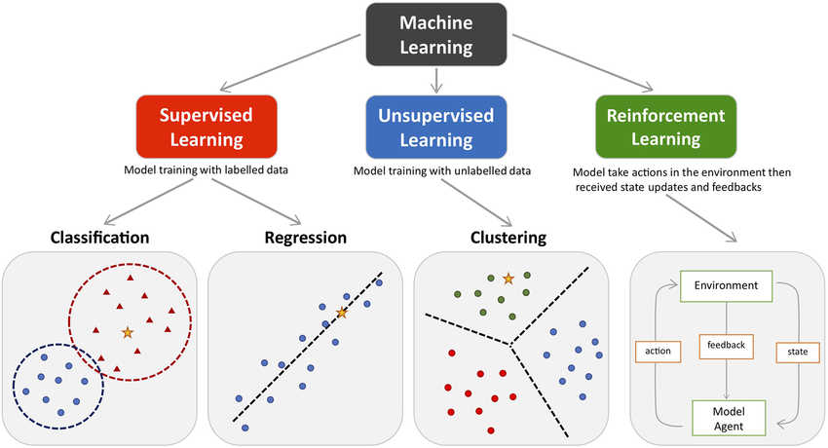
Machine Learning
Machine learning algorithms are broadly categorized into supervised, unsupervised, and reinforcement.

Slide 3
Machine Learning
1. Supervised Learning
Definition: Learns from labeled data, where both inputs and corresponding outputs (labels) are provided.
Goal: Learn a mapping function from inputs X to outputs Y.
Common Algorithms: Linear regression, SVM, decision trees, neural networks.
2. Unsupervised Learning
Definition: Learns from unlabeled data, without any explicit output.
Goal: Discover hidden patterns or structures in the input data.
Common Algorithms: K-means clustering, PCA, hierarchical clustering, autoencoders.
3. Reinforcement Learning
Definition: Learns by interacting with an environment, receiving rewards or penalties based on actions taken.
Goal: Learn a policy that maximizes cumulative reward over time.
Common Algorithms: Q-learning, Deep Q-Network (DQN), Policy Gradient methods.

Slide 4
Machine Learning
Classification vs. Regression
Aspect | Classification | Regression
Goal | Predict discrete labels or categories | Predict continuous numerical values
Output Type | Class labels (e.g., cat, dog, spam) | Real numbers (e.g., price, temperature)
Typical Algorithms | Logistic Regression, Decision Trees, SVM, k-NN, Neural Networks | Linear Regression, Ridge Regression, SVR, Neural Networks

Slide 5
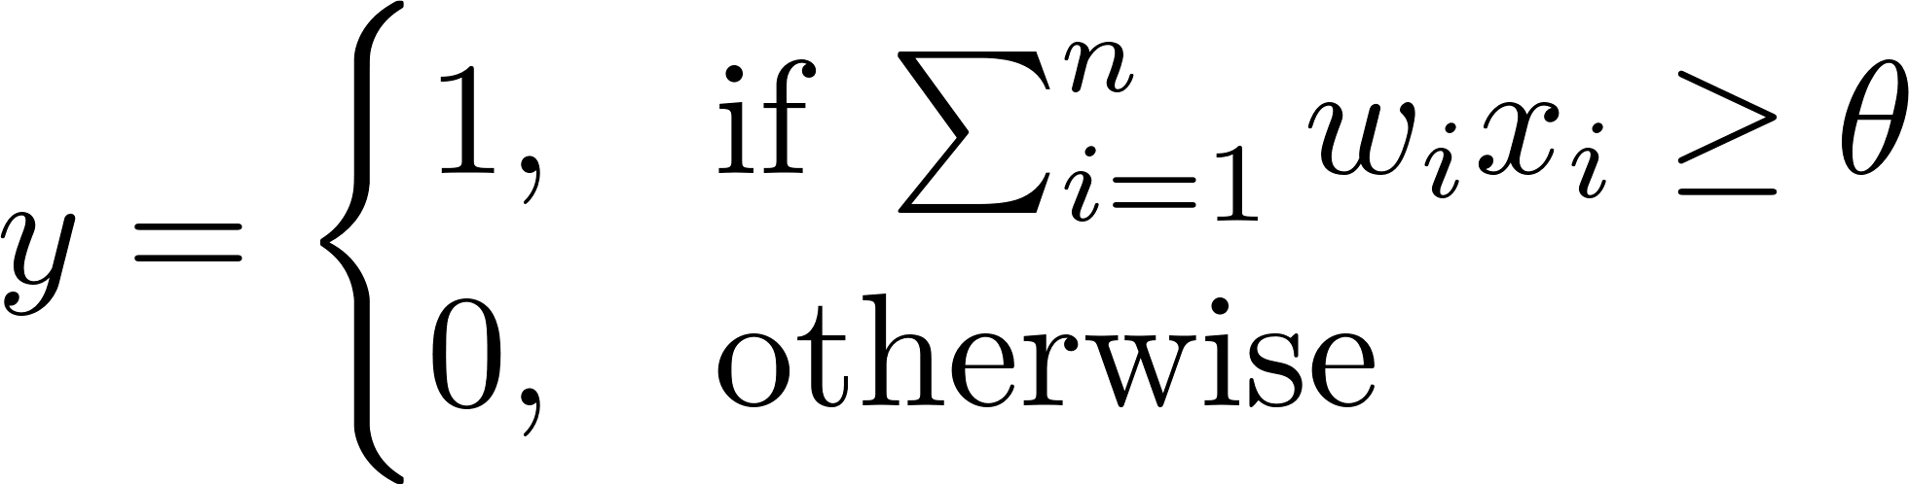
Threshold Logic Network
A Threshold Logic Network is a network of neurons (or nodes) where each node computes a weighted sum of its inputs and fires (outputs 1) only if the sum exceeds a certain threshold. It's a generalization of the classical perceptron.
Each Threshold Logic Unit (TLU) computes:
binary step activation

Slide 6
Fuzzy Logic Systems
Fuzzy Logic Systems use reasoning that mimics human thinking by allowing intermediate values between “true” and “false”. It’s based on fuzzy set theory, where variables may belong to multiple sets with degrees of membership.
Feature | Threshold Logic Network | Fuzzy Logic System
Output | Binary (0/1) | Fuzzy (in [0, 1]), crisp after defuzzfication.
Decision boundary | Hard threshold | Soft reasoning
Interpretability | Low | High (rule-based)

Slide 7
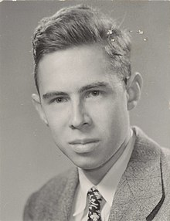
Perceptron
Frank Rosenblatt (July 11, 1928 – July 11, 1971) was an American psychologist notable in the field of artificial intelligent. He is sometimes called the father of deep learning.
In 1957 he started something really big. He "invented" a Perceptron program, on an IBM 704 computer at Cornell Aeronautical Laboratory.
Scientists had discovered that brain cells (Neurons) receive input from our senses by electrical signals.
The Neurons, then again, use electrical signals to store information, and to make decisions based on previous input.
Frank had the idea that Perceptrons could simulate brain principles, with the ability to learn and make decisions.
Notes:
In the views that the M-P neuron is not weighted and cannot process non-Boolean input, perceptron is proposed. This model was developed by Frank Rosenblatt in 1957.

Slide 8
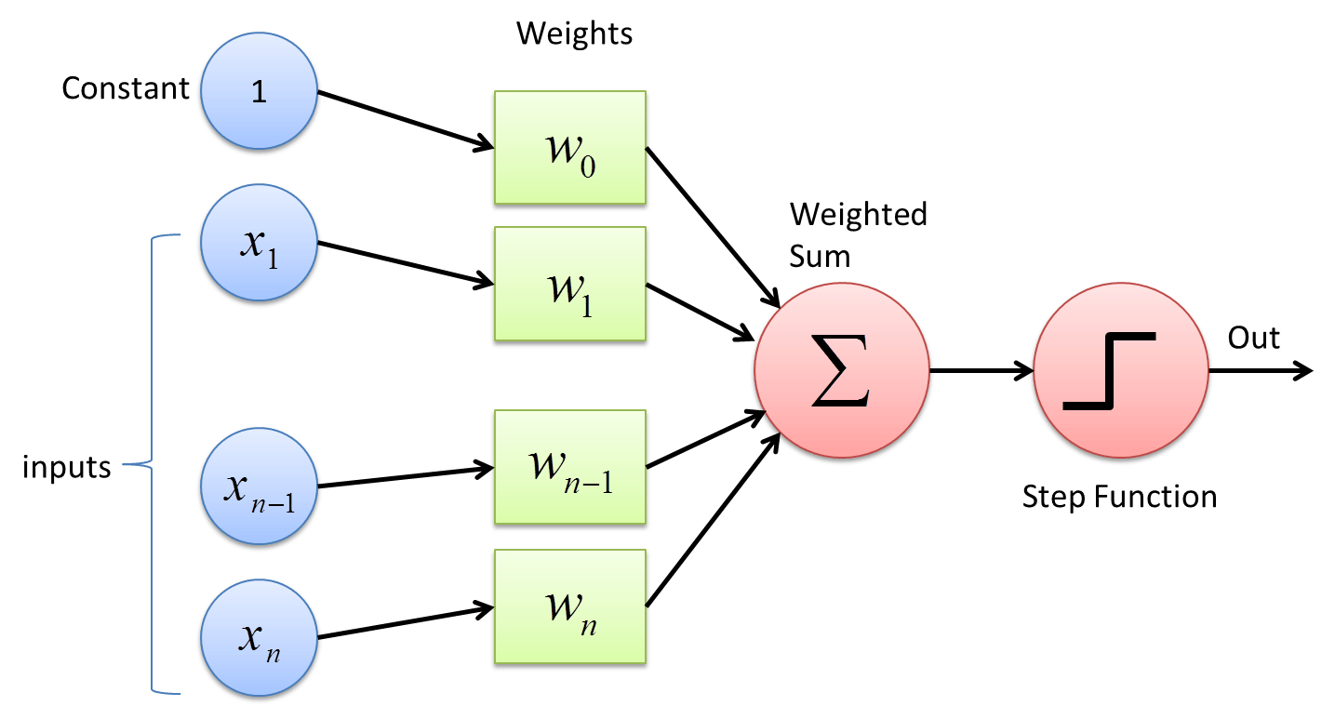
Perceptron
Notes:
The process begins by taking all the input values and multiplying them by their weights. Then, all of these multiplied values are added together to create the weighted sum. The weighted sum is then applied to the activation function, producing the perceptron's output. The activation function plays the integral role of ensuring the output is mapped between required values such as (0,1) or (-1,1). It is important to note that the weight of an input is indicative of the strength of a node. Similarly, an input's bias value gives the ability to shift the activation function curve up or down.

Slide 9
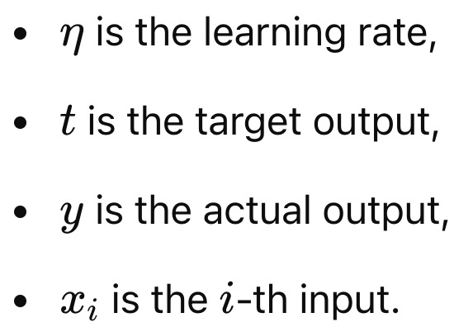
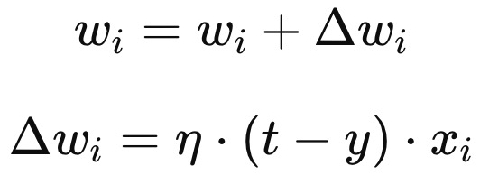
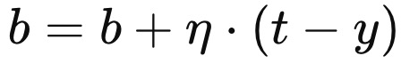
Perceptron
Training the Perceptron (Learning Algorithm)
Initialization: Start by initializing the weights and bias with small random values.
For each training example x:
Compute the output y based on the current weights and bias.
Update the weights and bias if the prediction is incorrect:
Update the bias b similarly:
Repeat the process until all training examples are correctly classified or the algorithm converges.

Slide 10
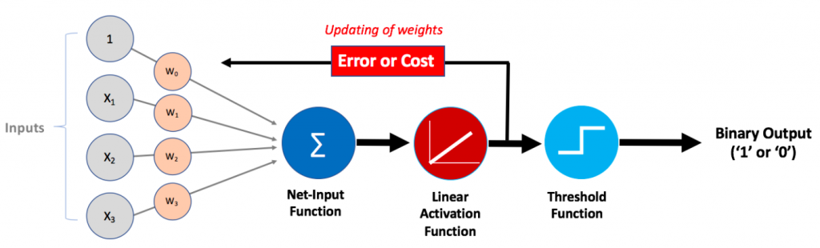
Adaline (Adaptive Linear Neuron)
ADALINE is a type of neural network that is based on the linear activation function. It is very similar to the perceptron but differs in its learning rule. The output of the ADALINE neuron is a linear combination of inputs, and the error is calculated using the difference between the desired output and the actual output.

Slide 11
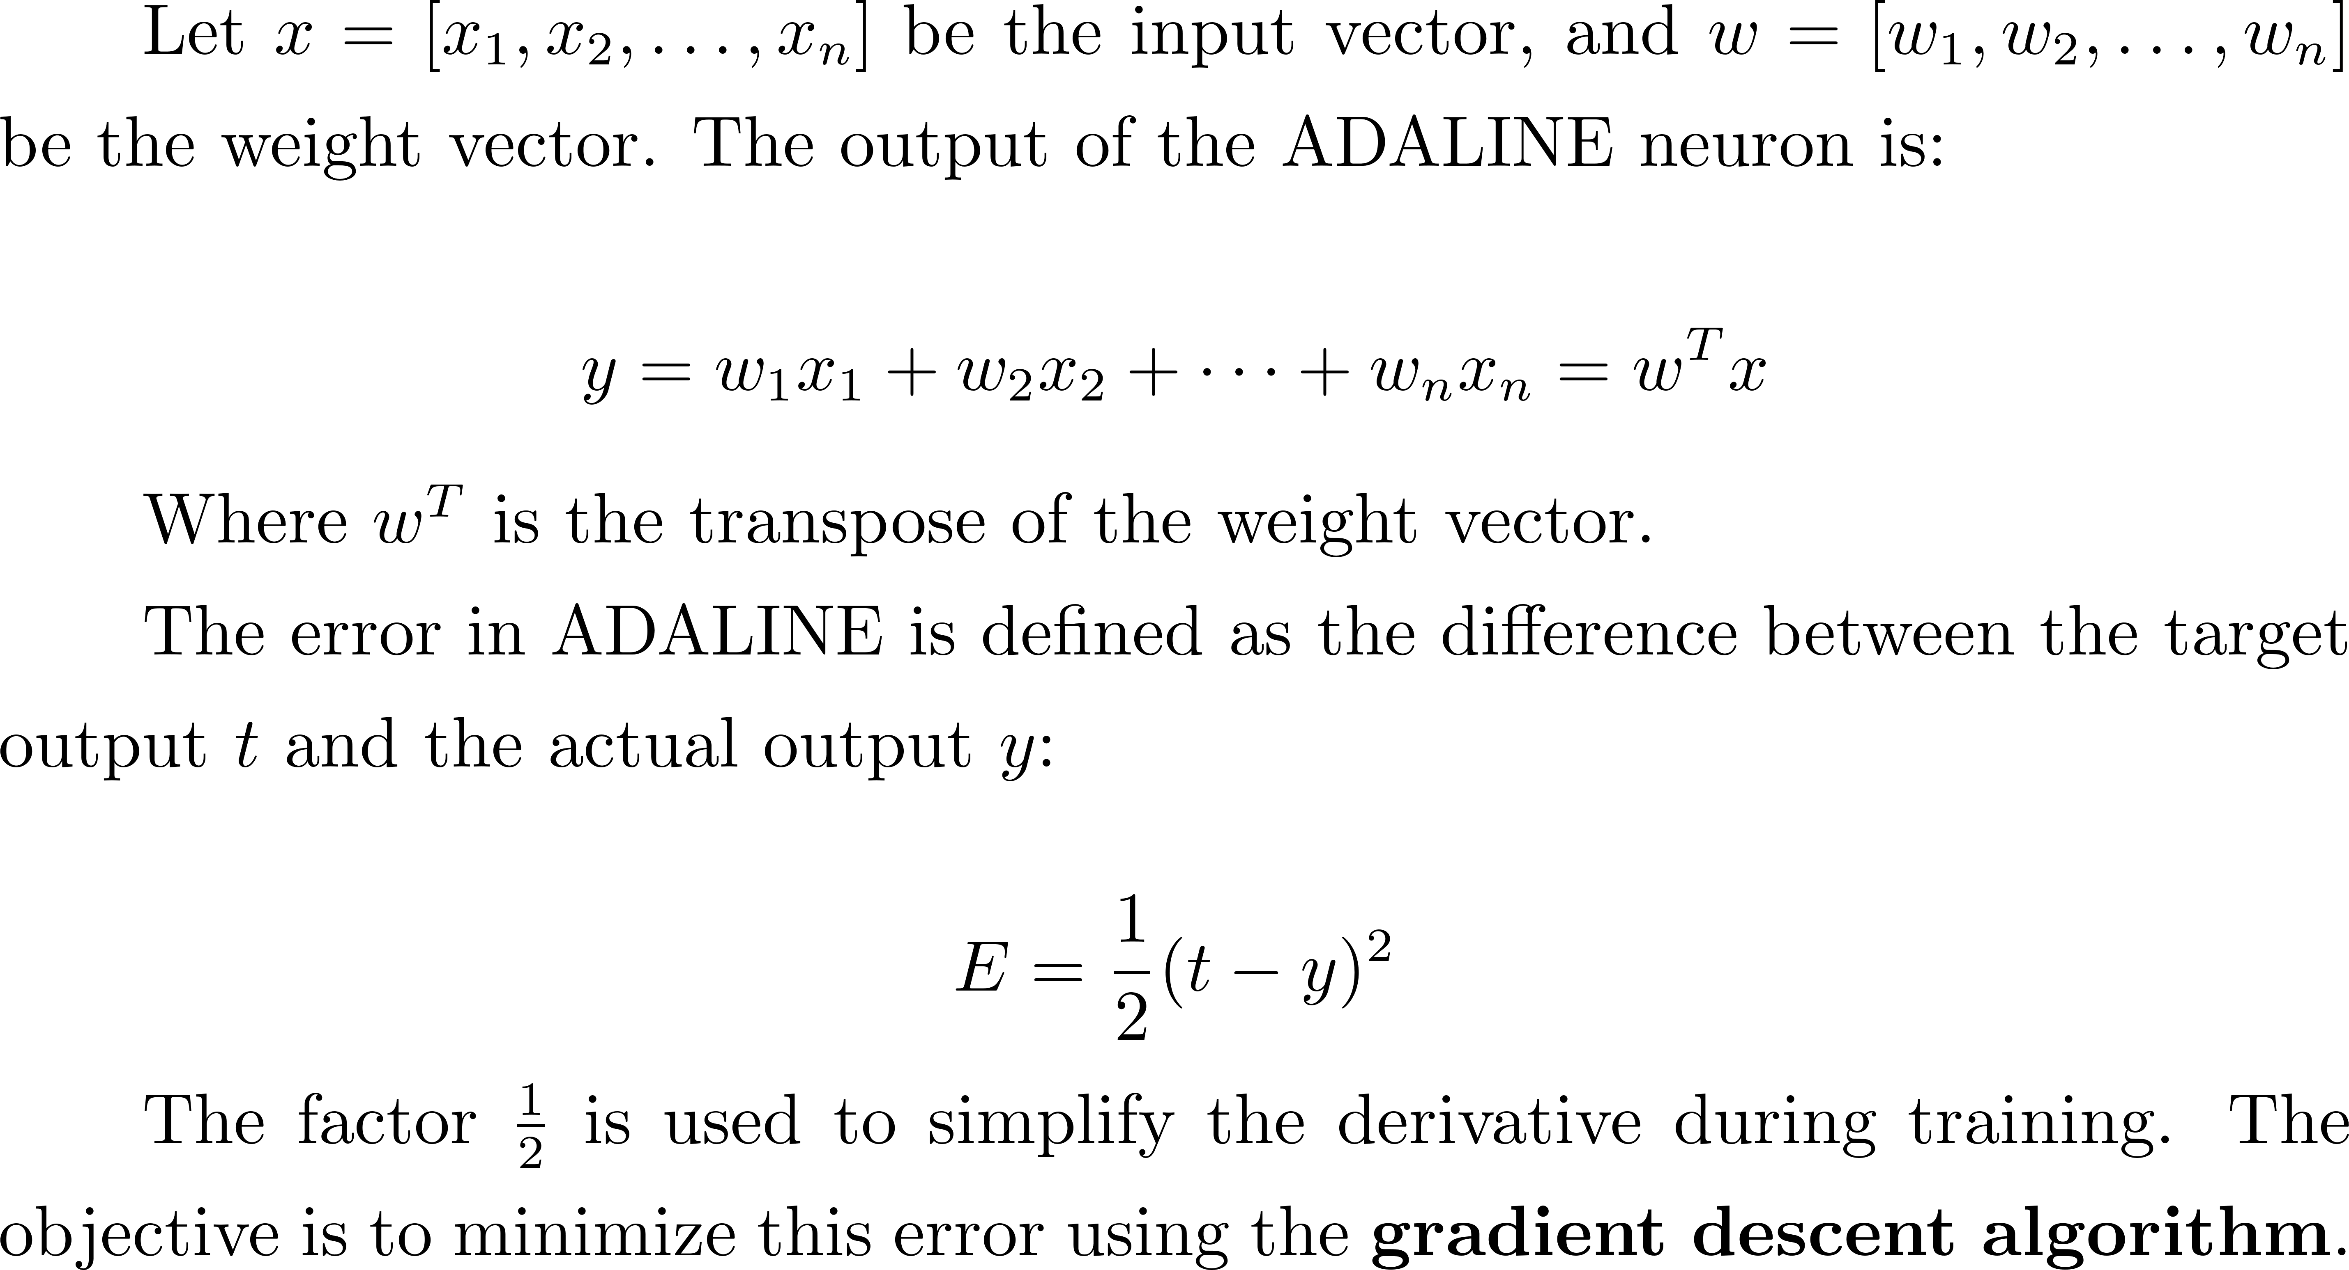
Adaline (Adaptive Linear Neuron)

Slide 12
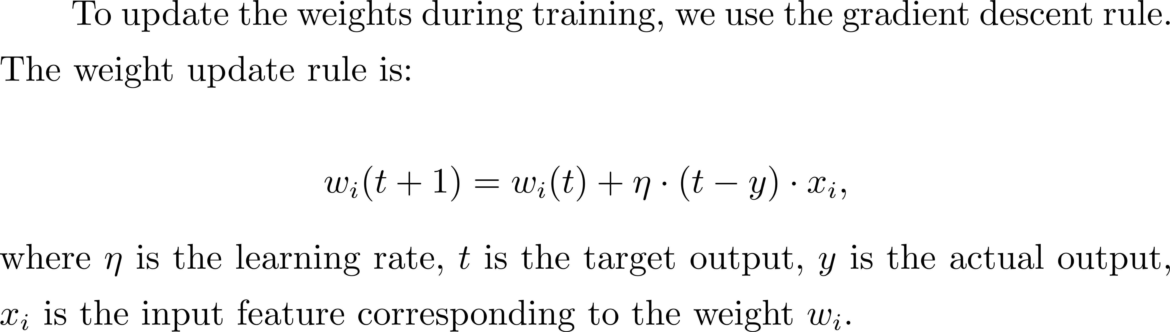
Adaline (Adaptive Linear Neuron)
Learning Rule
Steps for Training ADALINE
Repeat
Initialize weights randomly
Calculate the output
Calculate the output
Compute the error
Convergence

Slide 13
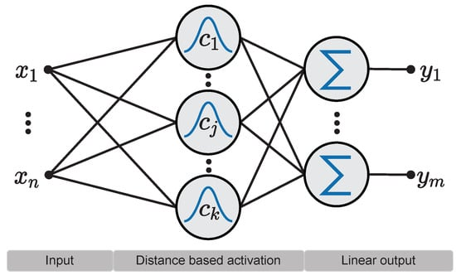
Radial Basis Function (RBF) Neural Networks
Radial Basis Function (RBF) Neural Networks are a specialized type of Artificial Neural Network (ANN) used primarily for function approximation tasks.
Three-layer architecture
Notes:
RBF network in its simplest form is a three-layer feedforward neural network. The first layer corresponds to the inputs of the network, the second is a hidden layer consisting of a number of RBF non-linear activation units, and the last one corresponds to the final output of the network.
Activation functions in RBFNs are conventionally implemented as Gaussian functions. Here shows an example of the RBFN structure.

Slide 14
Radial Basis Function (RBF) Neural Networks
RBF and MLP belong to a class of neural networks called feed-forward networks.
What is the difference between RBF and MLP?
In RBF, each hidden unit act as a point in input space and activation/output for any instance depends on the distance between that point(Hidden Unit) and instance(a sample point)
RBF learns two kinds of parameters: 1) Centers and width of RBFs. 2) Weights to from linear combination of outputs obtained from hidden layer.
Notes:
RBF and MLP belong to a class of neural networks called feed-forward networks.
Hidden layer of RBF is different from MLP. It performs some computations. Each hidden unit act as a point in input space and activation/output for any instance depends on the distance between that point(Hidden Unit) and instance(Also a point in space).
Thus, RBF learns two kinds of parameters: 1) Centers and width of RBFs 2) Weights to from linear combination of outputs obtained from hidden layer

Slide 15
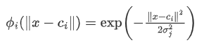
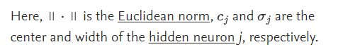
Radial Basis Function (RBF) Neural Networks
The output of the i-th activation function in the hidden layer of the network can be calculated based on the distance between the input pattern x and the center c_{i} as follows:

Slide 16
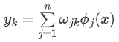
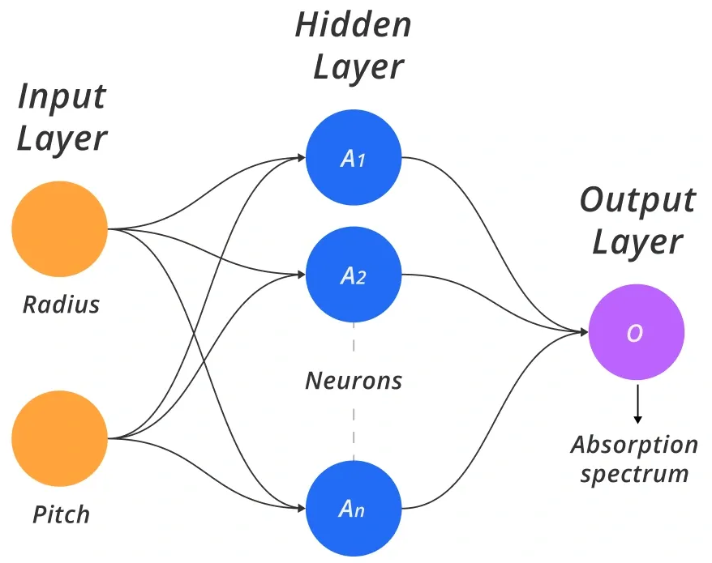
Radial Basis Function (RBF) Neural Networks
Then, the output of the node k of the output layer of the network can be calculated as follows:

Slide 17
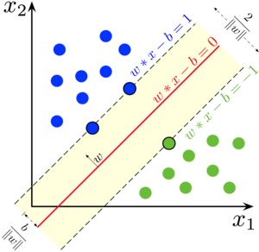
Support Vector Machine
Support Vector Machines (SVM) are powerful supervised learning algorithms widely used for classification and regression tasks.
SVM is a discriminative classifier that finds an optimal decision boundary (hyperplane) to separate different classes in a dataset. It works by maximizing the margin between data points of different classes.

Slide 18
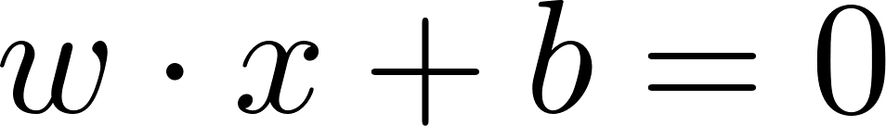
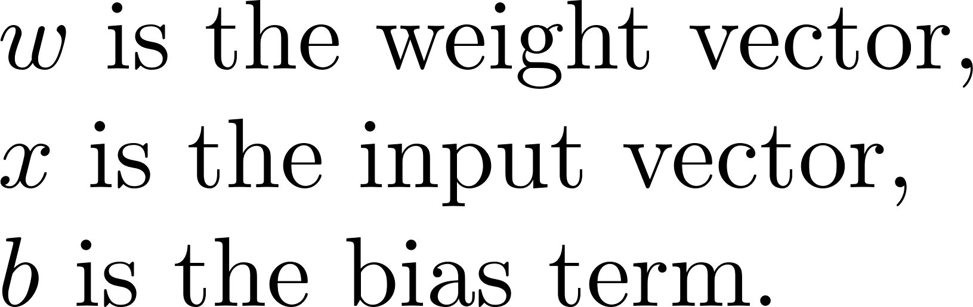
Support Vector Machine
Given a dataset with two classes, SVM finds a hyperplane that maximizes the margin.

Slide 19
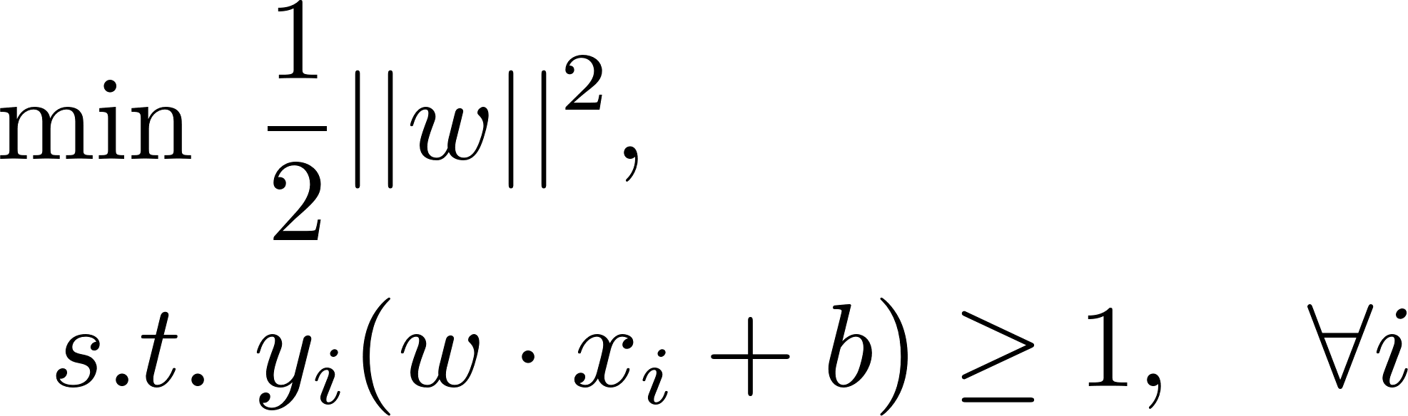
Support Vector Machine
Maximize the Margin
maximizes the margin
classification error

Slide 20
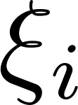
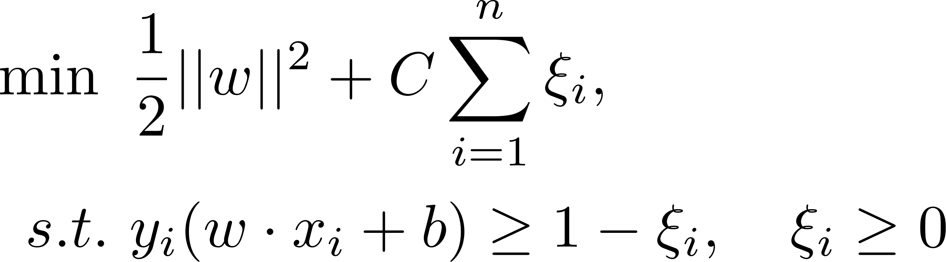
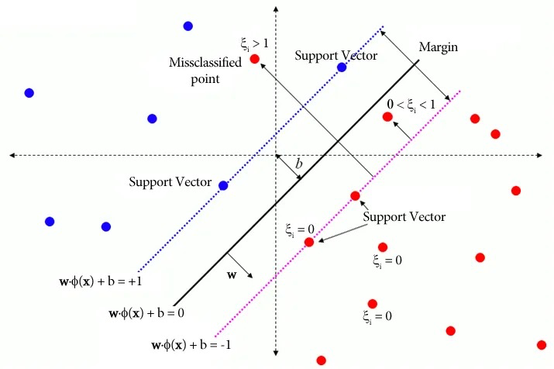
Support Vector Machine
Soft-Margin SVM (For Non-Separable Data)
introduce slack variables to allow some misclassifications:

Slide 21
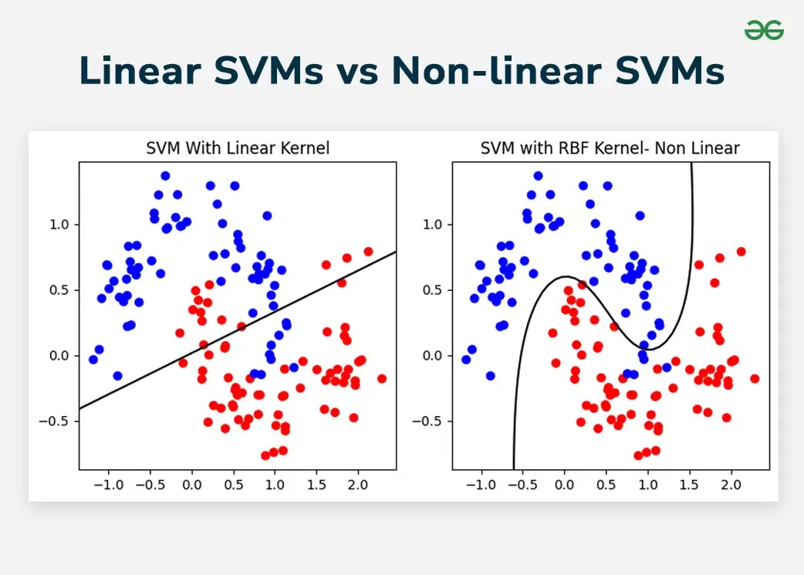
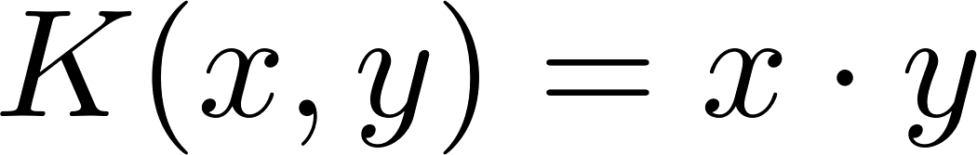
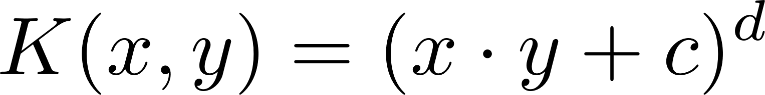
Support Vector Machine
When data is not linearly separable
Common Kernels:
Linear Kernel:
Polynomial Kernel:
Radial Basis Function (RBF) Kernel:
Sigmoid Kernel:
Notes:
If data is not linearly separable, SVM maps data into a higher-dimensional space using a kernel function \( K(x_i, x_j) \), which replaces the dot product:

Slide 22
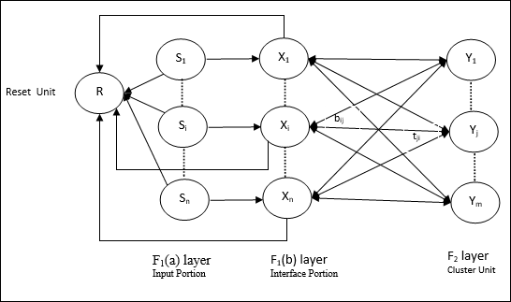
ART-1 Network
ART1 (Adaptive Resonance Theory 1) is a type of neural network introduced by Stephen Grossberg and Gail Carpenter in the 1980s. It is designed for clustering and pattern recognition of binary input vectors.
The hallmark of ART networks is their ability to learn new patterns without forgetting old ones, solving the stability-plasticity dilemma in neural learning systems.
Binary inputs only

Slide 23
ART-1 Network
Input Layer (F1 Layer)
Receives input vector (Binary)
Normalizes and processes data for comparison
Category Layer (F2 Layer)
Contains m category neurons (can grow)
Each neuron represents a cluster
A neuron is activated if the input matches its template within vigilance
Vigilance parameter ρ controls similarity required for category matching.

Slide 24
ART-1 Network
For each input vector x(i):
matched = False
For j = 1 to K:
match_score = ||x(i) ∧ w(j)||_1 / ||x(i)||_1
If match_score ≥ ρ:
matched = True
Assign x(i) to category j
Update prototype:
w(j) = w(j) ∧ x(i)
Break
If not matched:
K = K + 1
Create new category j = K
w(K) = x(i)
Assign x(i) to new category K
Return:
Category assignments A, category prototypes W

Slide 25
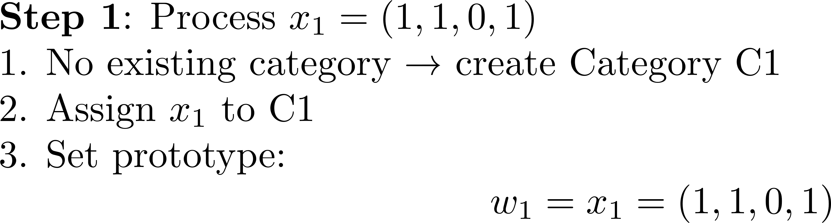
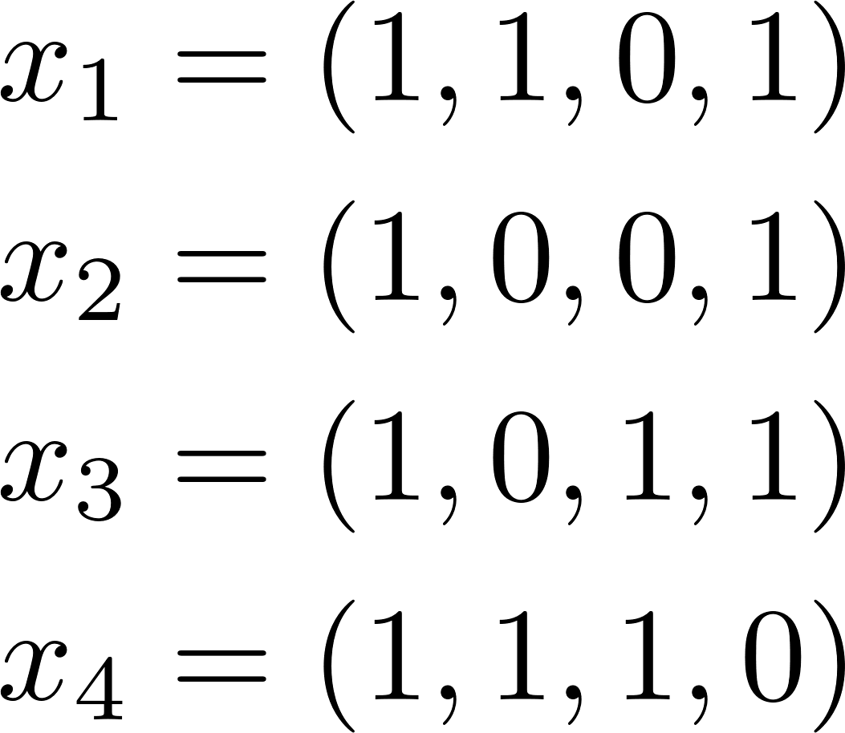
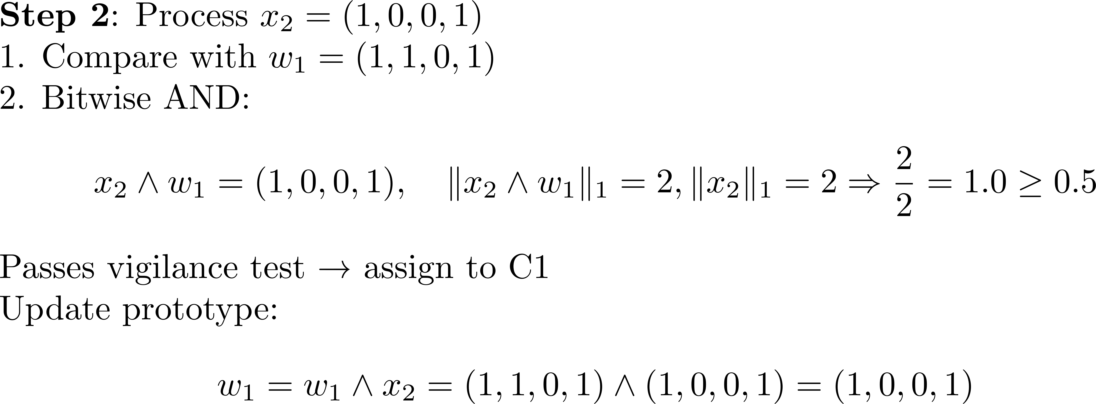
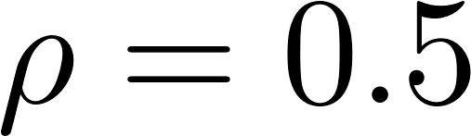
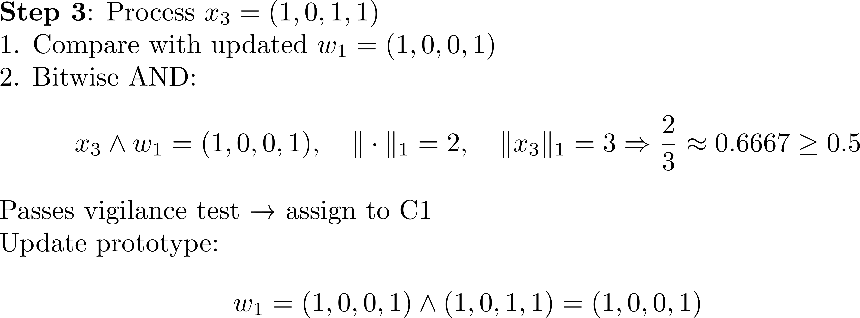
ART-1 Network

Slide 26
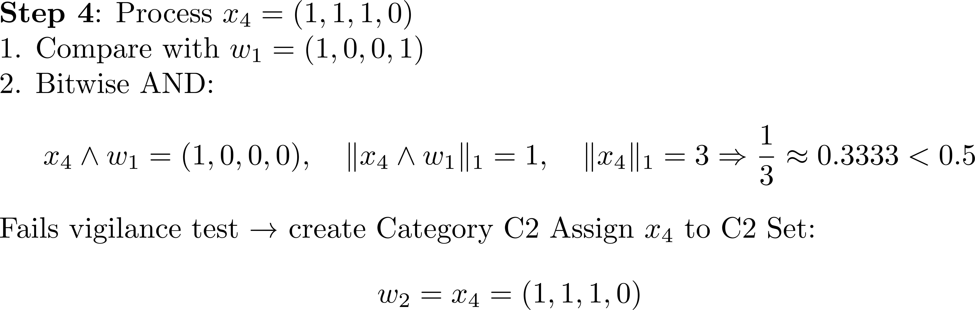
ART-1 Network
Final Clustering Result
x1​ | C1
x2 | C1
x3 | C1
x4 | C2

Slide 27
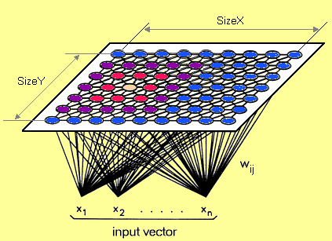
Self-Organizing Map
A Self-Organizing Map (SOM) is a type of artificial neural network used for unsupervised learning and data visualization.
It reduces high-dimensional data into a lower-dimensional (typically 2D) representation while preserving the topological relationships of the input data.
Clustering
Feature Extraction
Dimensionality Reduction

Slide 28
Self-Organizing Map
Output Layer
Output Layer (Map): A 2D grid of neurons, each associated with a weight vector of the same dimensionality as the input data.
Input Layer: Represents the feature vectors of the dataset.
Input Layer
The network organizes itself through a competitive learning process, where similar inputs map to nearby neurons.

Slide 29
Self-Organizing Map
Training:
Step 1: Initialize the weights w_{ij} random value may be assumed. Initialize the learning rate α.
Step 2: Calculate squared Euclidean distance.
D(j) = Σ (wij – xi)^2 where i=1 to n and j=1 to m
Step 3: Find index J, when D(j) is minimum that will be considered as winning index.
Step 4: Update BMU and its neighbors:
Step 5: Update the learning rule by using :
α(t+1) = 0.5 * t
Step 6: Test the Stopping Condition.

Slide 30
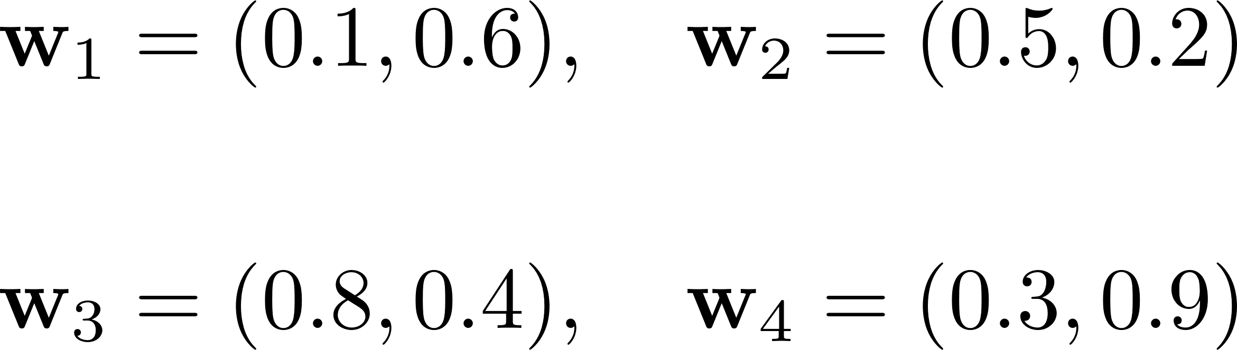
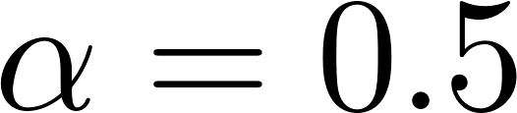
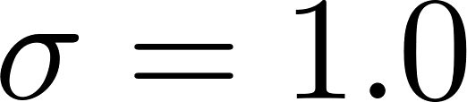
Self-Organizing Map
We have three input vectors:
The SOM grid is 2×2, meaning there are four neurons, each with a randomly initialized weight vector:

Slide 31
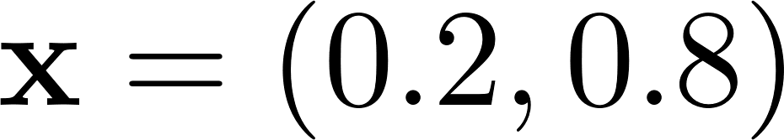
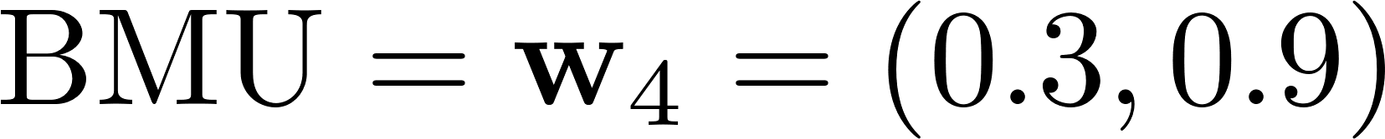
Self-Organizing Map
Step 1: We randomly select an input sample:
Step 2: We calculate the Euclidean distance between the input vector and all neurons' weight vectors:
The neuron with the smallest distance is selected as the BMU:

Slide 32
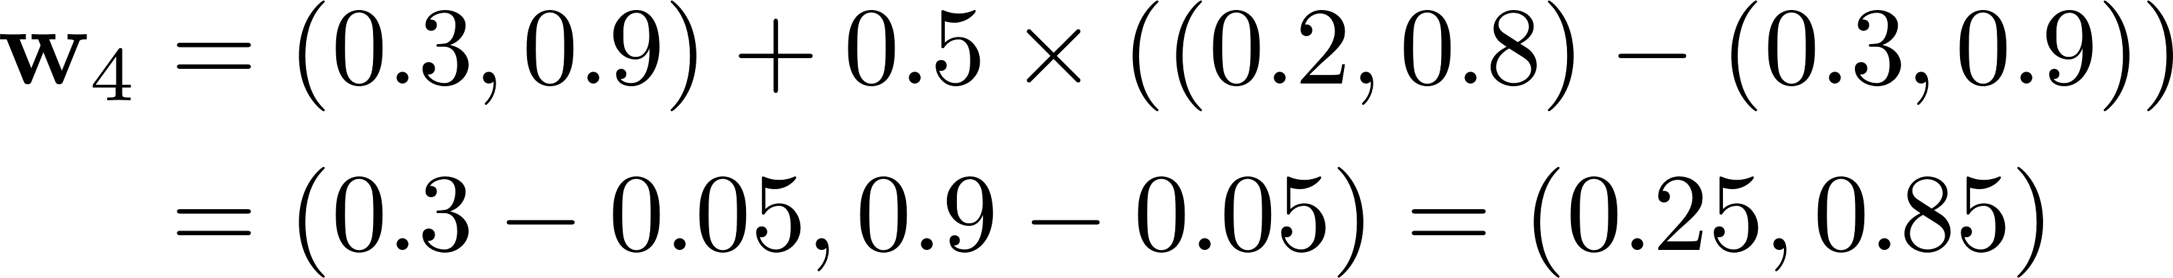
Self-Organizing Map
The neuron with the smallest distance is selected as the BMU:
Step 4: The BMU’s weight vector is updated using the following rule:
Substituting values:
Step 5: Repeat for Other Input Vectors

Slide 33

Simulated Annealing
It’s inspired by the annealing process in metallurgy, where materials are heated and slowly cooled to achieve a stable structure with minimal energy.
What is Physical Annealing?
When the material is hot, the molecular structure is weaker and is more susceptible to change.
Notes:
The Simulated Annealing algorithm is based upon Physical Annealing in real life. Physical Annealing is the process of heating up a material until it reaches an annealing temperature and then it will be cooled down slowly in order to change the material to a desired structure. When the material is hot, the molecular structure is weaker and is more susceptible to change. When the material cools down, the molecular structure is harder and is less susceptible to change.

Slide 34

Simulated Annealing
Another important part of this analogy is the following equation from Thermal Dynamics:
Notes:
temperature t along with the Boltzmann constant k.

Slide 35
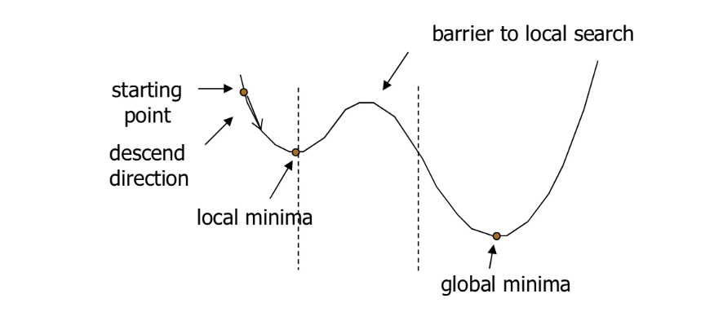
Simulated Annealing
Simulated Annealing (SA) mimics the Physical Annealing process but is used for optimizing parameters in a model. This process is very useful for situations where there are a lot of local minima such that algorithms like Gradient Descent would be stuck at.
Notes:
SA is capable of finding a global maximum and not stuck at local minima.

Slide 36
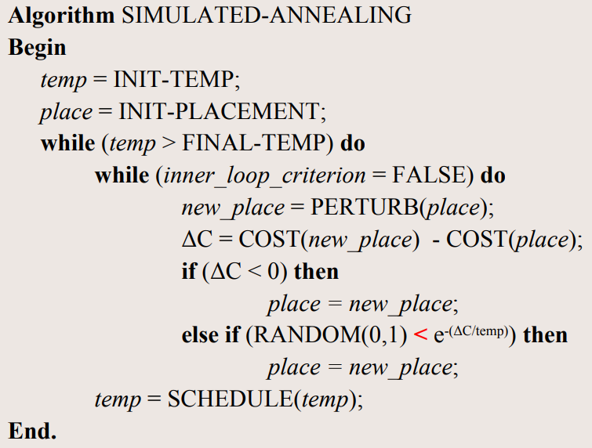
Simulated Annealing
Algorithm

Slide 37
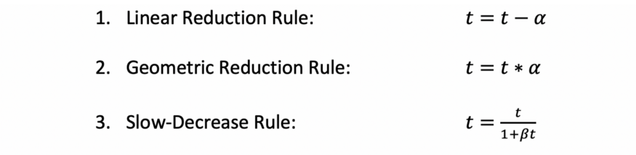
Simulated Annealing
Algorithm
Each reduction rule reduces the temperature at a different rate and each method is better at optimizing a different type of model. For the 3rd rule, beta is an arbitrary constant.

Slide 38
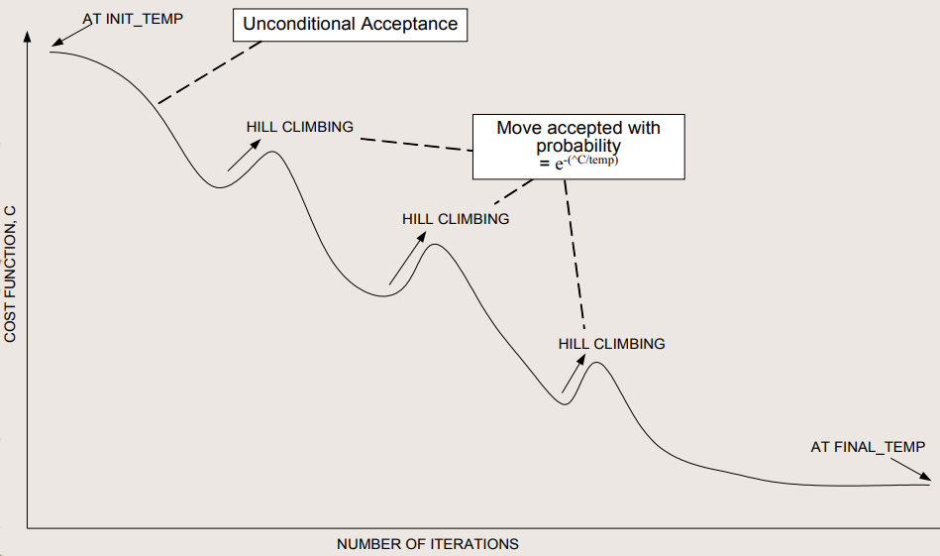
Simulated Annealing

Slide 39
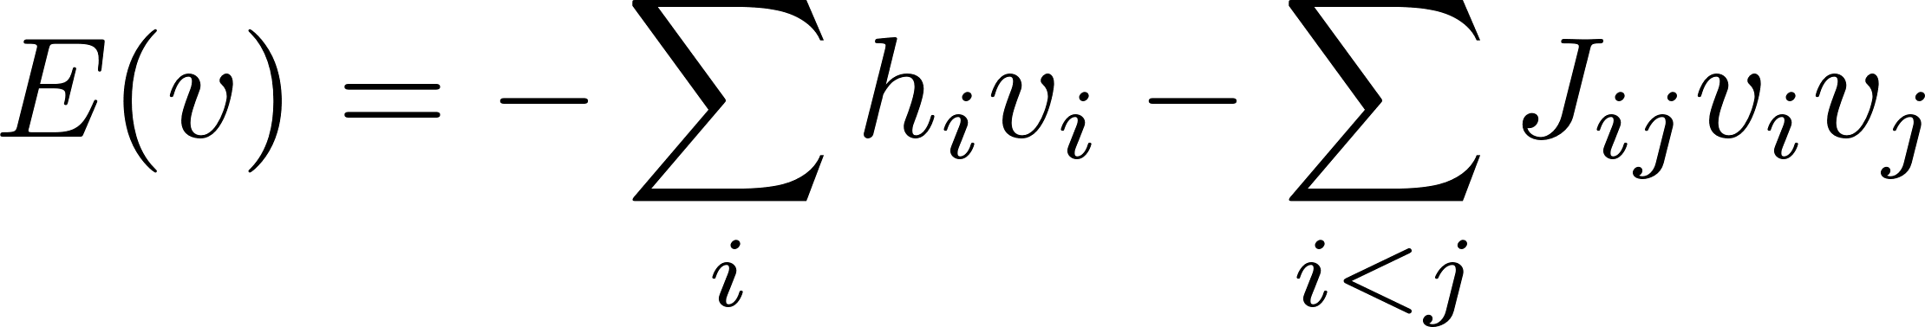
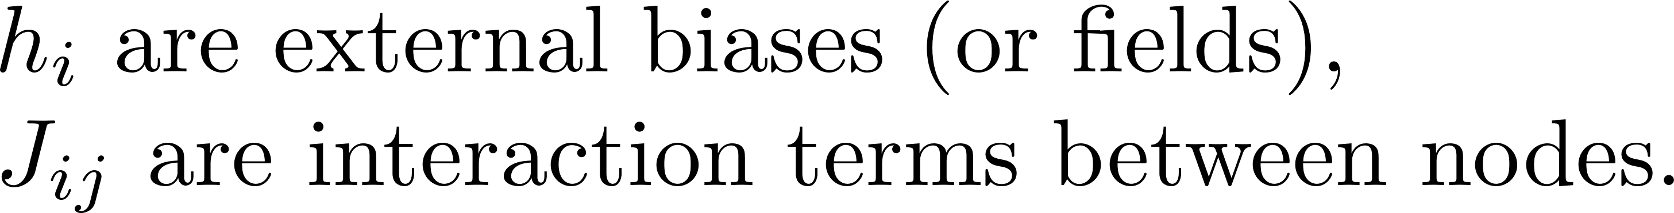
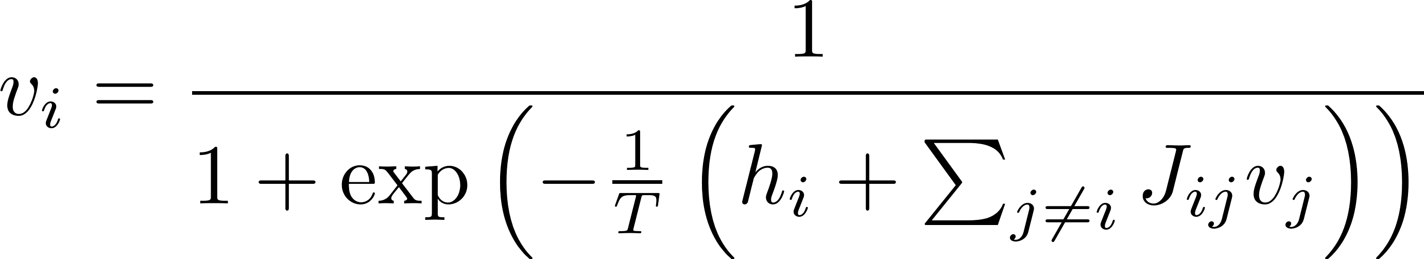
Mean Field Annealing
Mean Field Annealing is an optimization method inspired by statistical mechanics. It approximates the behavior of Simulated Annealing by replacing the stochastic binary decisions with deterministic probabilistic expectations.
Assume a system with energy function:
The mean-field update rule is:
A deterministic approximation of Simulated Annealing (SA) that replaces stochastic sampling with a mean-field approximation.

Slide 40
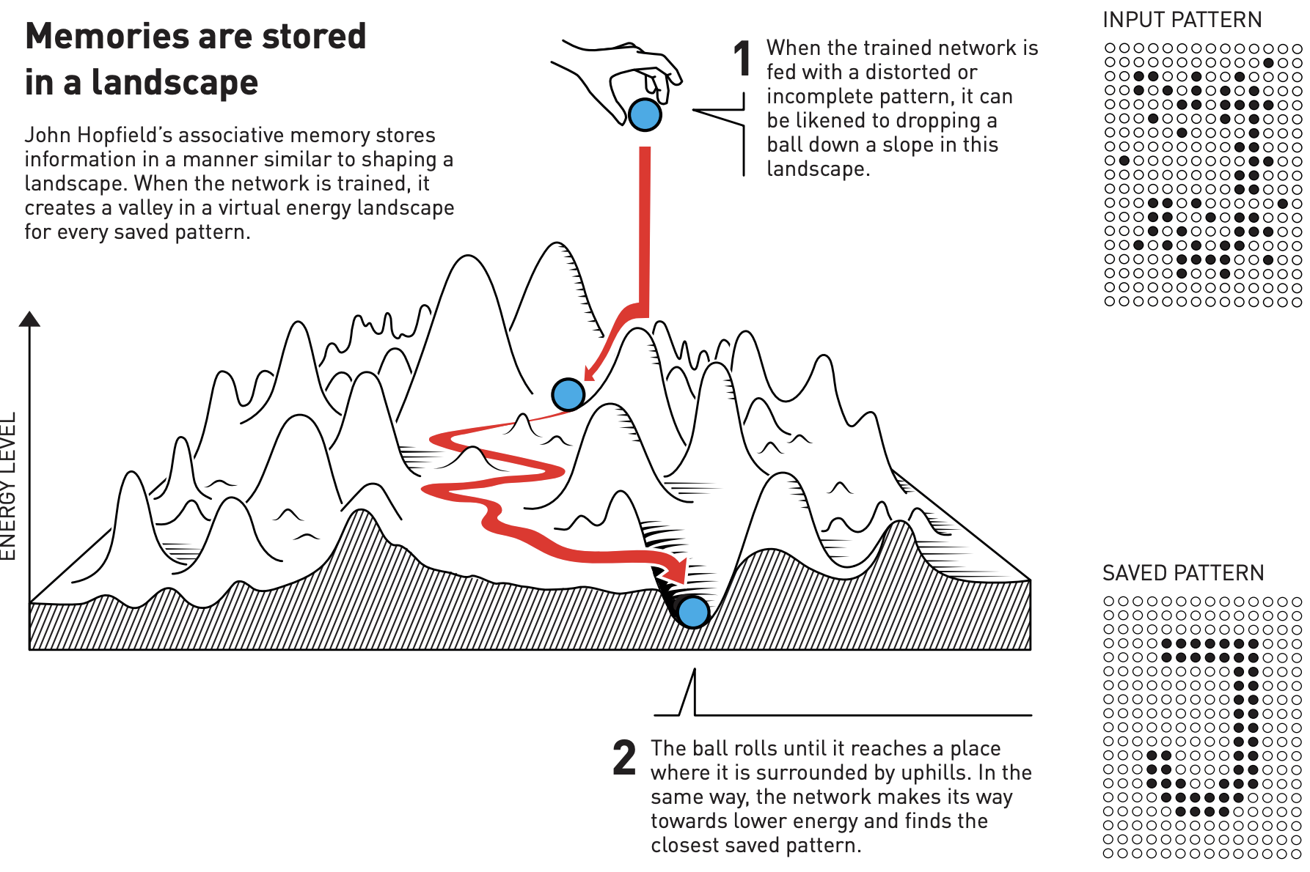
Discrete Hopfield Network
www.nobelprize.org: Using physics to find patterns in information
https://www.nobelprize.org/uploads/2024/10/popular-physicsprize2024-2.pdf
Notes:
John Hopfield’s associative memory model visualizes stored memories as valleys in an energy landscape. When the network is given a partial or distorted input (dropping the ball), it “rolls” through the landscape until it settles in the nearest valley, representing the closest stored memory. This process allows the network to restore incomplete or noisy data by finding the pattern with the lowest energy.

Slide 41
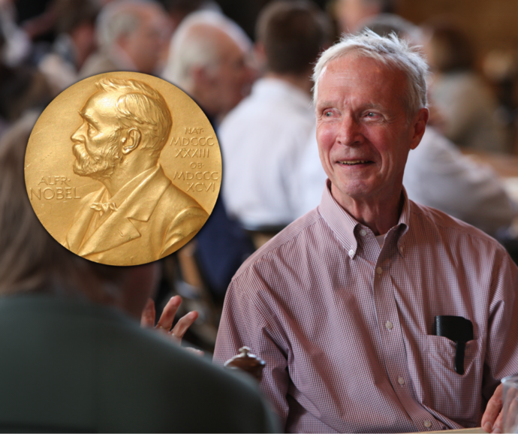
Discrete Hopfield Network
Hopfield Neural Network (HNN) is a type of recurrent neural network.
Structure
Consist of a single layer of fully connected neurons.
Each neuron is connected to every other neuron, with symmetric weights.
John Joseph Hopfield (born July 15, 1933),
American physicist, Princeton University
Functionality
Store patterns as stable states (attractors).
Retrieve stored patterns from partial or noisy inputs.

Slide 42
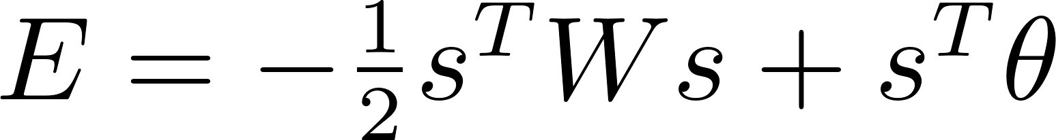
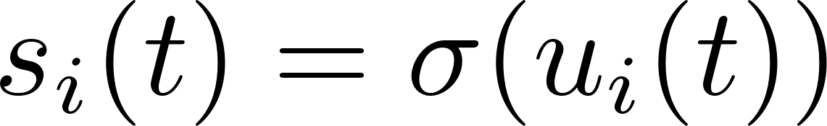

Discrete Hopfield Network
Energy Function: HNNs utilize an energy function to describe the network's state. The network evolves to minimize this energy, converging to a stable state that represents a stored pattern.
For discrete-time HNN
For continuous-time HNN
Each neuron's state is updated based on the weighted sum of its inputs.
Convergence → A stored pattern

Slide 43


Discrete Hopfield Network
Hebbian Learning Rule
In classical Hopfield Networks these patterns are bipolar (binary)
set diagonal elements
The weight matrix W stores the patterns, which can be retrieved starting with a state pattern s(0)
Pattern Retrieval
Energy function decreases
Notes:
samples

Slide 44




Discrete Hopfield Network
Hebbian Learning Rule
Introduced by Donald Hebb in 1949
Storkey Learning Rule
Introduced by Amos Storkey in 1997
For each new pattern
where,
Greater capacity than a corresponding network trained using the Hebbian rule.
Ref: https://en.wikipedia.org/wiki/Hopfield_network

Slide 45


Discrete Hopfield Network
Consider a black and white image x_{homer}:
HNN
Notes:
the outer product of this black and white image

Slide 46

Boltzmann Machine
A Boltzmann Machine (BM) is a type of stochastic recurrent neural network. It is inspired by statistical mechanics and is useful for learning probabilistic distributions over binary vectors.
Structure of a Boltzmann Machine
1. Nodes (Neurons):
Each node is a binary unit (either 0 or 1).
Two types: visible units (input) and hidden units (learn features).
2. Connections:
Every unit is connected to every other unit except to itself.
No directionality – it's an undirected graph.
Hinton, G.E. (2002). Training products of experts by minimizing contrastive divergence.

Slide 47
Boltzmann Machine
The network assigns an energy to each possible state (configuration of nodes), defined as:
Energy-Based Model
weights between visible-visible and hidden-hidden units (only in full BM)

Slide 48

Boltzmann Machine
Sampling via Gibbs Sampling
Gibbs Sampling lets us sample from the joint distribution of the BM.
Fix all nodes except one.
Update one node at a time using its conditional probability:
Update unit i
Sigmoid activation

Slide 49



Boltzmann Machine
A Boltzmann Machine defines a joint probability over visible and hidden units:
The probability of visible vector

Slide 50

Boltzmann Machine
Maximize likelihood P(v) of the training data → minimize energy of real data
Positive phase: strengthen connections based on real data
Negative phase: weaken connections based on samples from the model

Slide 51

Boltzmann Machine
Restricted Boltzmann Machine
BM is powerful, but slow and hard to train. So we use a simplified version: RBM.
No connections between units within the same layer.
Only visible-to-hidden connections.

Slide 52
﻿Fuzzy Systems
i.e., each membership degree is itself a fuzzy set
Feature | Type-I Fuzzy System | Type-II Fuzzy System
Membership Function | Crisp (single value) | Fuzzy (range or fuzzy set)
Uncertainty Handling | Low to moderate | High
Complexity | Low | High
Use Case | Simple or moderately uncertain systems | Highly uncertain systems (e.g., noisy environments)
Defuzzification | Direct | Requires type-reduction first
Type | Pros | Cons
Type-I | Simple, efficient, widely used | Limited ability to handle complex uncertainty
Type-II | Robust, handles uncertainty in rules & inputs | Computationally expensive, harder to design

Slide 53
Evolutionary Algorithms - GA
Genetic Algorithm
Genetic Algorithm (GA) is a bio-inspired metaheuristic optimization method based on the principles of natural selection and genetic evolution.
1. Initialize population P with N random individuals
2. Evaluate the fitness f(x) of each individual in P
3. Repeat until stopping criterion is met:
a. Select parents from P using a selection strategy
b. Apply crossover to selected parents to produce offspring
c. Apply mutation to the offspring with some probability
d. Evaluate the fitness of the new offspring
e. Form a new population P by selecting from parents and offspring (replacement)
4. Return the best individual found

Slide 54






Swarm Intelligence Algorithms - PSO
Particle Swarm Optimization
inspired by the social behavior of birds flocking or fish schooling, proposed by Kennedy and Eberhart in 1995.
1. Velocity Update
inertia weight (balance exploration/exploitation)
cognitive coefficient (self confidence)
social coefficient (swarm confidence)
random values
2. Position Update

Slide 55
Genetic Algorithms vs. Particle Swarm Optimization
 | Genetic Algorithm (GA) | Particle Swarm Optimization (PSO)
Inspiration | Natural evolution & genetics | Bird flocking and fish schooling
Search Operators | Crossover and mutation | Velocity and position updates
Information Sharing | Through recombination (crossover) | Through group best and individual best
Key Parameters | Population size, crossover rate, mutation rate | Swarm size, inertia weight, cognitive/social coefficients

Slide 56
How does reinforcement learning differ from supervised learning?
Notes:
Reinforcement learning learns by interacting with an environment and receiving feedback (rewards/penalties), whereas supervised learning learns from labeled data with known outputs.

Slide 57
What is the main difference between a perceptron and ADALINE?
Notes:
Perceptron uses a binary step function for output, while ADALINE uses a linear activation and updates weights based on a continuous error.

Slide 58
What are the two sets of parameters learned in RBF networks?
Notes:
1) The centers and widths of radial basis functions. 2) The weights from hidden to output layer.

Slide 59
What is the objective of an SVM?
Notes:
To find a hyperplane that maximizes the margin between different classes.

Slide 60
What technique does soft-margin SVM introduce?
Notes:
Slack variables to allow some misclassifications in non-linearly separable data.

Slide 61
What is the role of the vigilance parameter ρ in ART1 networks?
It controls the required similarity for category matching. Higher ρ leads to stricter matching.

Slide 62
How does a Self-Organizing Map (SOM) preserve topology?
Notes:
By ensuring that similar input vectors map to neighboring neurons on the output grid.

Slide 63
What kind of energy function does a Hopfield Network minimize?
Notes:
A quadratic energy function that decreases with each state update, leading to convergence.

Slide 64
In a simulated annealing process, the current solution has an energy of E_current=5.0, and the candidate solution has an energy of E_new=7.5. If the current temperature is T=2.0, compute the acceptance probability.

Slide 65
Thanks

